Slide 1

General Instructions
Md. Mazid-Ul-Haque
Lecturer
Department of Computer Science, FST
American International University-Bangladesh
Email: mazid@aiub.edu

Slide 2
Contents
Classroom Policy
Assessment Policy
Consultation & Commutation
Important
About Me
Finally

Slide 3
Classroom Policy
* You must be present in the class within 10 minutes of the class starting time.
* Regardless of the marks for attendance, you must have at least 80% attendance. Below 80% attendance will result into discontinuation from the course.
* You can ask questions as many times as it is needed. Also, you should respond in class when the teacher addresses the class.
* Recording of class lectures offline/online is officially discouraged.
* During online class time, teacher can ask any student to respond/turn on camera and students must comply. Failing to do so, may result in penalty.
* Mutual respect among the students should be maintained. Any kind of bullying, disrespect towards any fellow classmate will result into disciplinary actions.
* While joining online class, make sure to check your microphone, camera is muted or not. No need to turn on camera, microphone unless you are told.
* Any tasks assigned to complete in class time must be completed and must be submitted within the given portion of the class time.
* In online, sometimes the teacher will take manual attendance and sometimes will download. In case of manual attendance, it can be taken any time during class hour. Failing to respond will result into your absence regardless of your entry in the downloaded attendance.

Slide 4
Assessment Policy
Prior notice will be posted in Teams(online)/Portal regarding every exam/assessment with date, time. So, even after getting notified if you miss any of the exam/assessment, no excuses will be considered.
During online assessments(quizzes, VIVAs, exams etc.) your camera must be on. Failing to comply with the Teacher’s declaration to turn on camera, your assessments marks will be discarded.
Deadline for each assigned assessments must strictly be maintained. Late submission will not be allowed.

Slide 5
Consultation & Commutation-1
You are always welcome if you need course topic related consultation during consulting hours.
You must communicate regarding any course related issue during consulting hours.
You must not text/email/call during night and during holidays unless you have the Teacher’s prior permission.

Slide 6
Consultation & Commutation-2
Again, you must not text/email/call during night and during holidays unless you have the Teacher’s prior permission.
For emailing, use your official student email ID provided by AIUB (xx-xxxxx-x@student.aiub.edu). You must write a proper email – with clear email subject, proper email body clearly explaining the purpose of the email and lastly- your info – Name, ID, Course Name[Section]. Login to: https://outlook.office365.com/mail/
You must WRITE your ID, Course Name[Section] while Texting me/starting a conversation with me in MS TEAMS.

Slide 7

Consultation & Commutation-3
Any sort of social media acronyms are strictly prohibited in email and texts.

Slide 8
Important-1
You must follow these general instructions for this course during this semester.
01
Some rules-policies can be relaxed if the student has VALID REASON(S), and valid reason does not mean any fake excuse. You must have solid proof, documentation for your excuse.
02
You must inform the Teacher about any critical situation you are in (for which you are unable to fulfill any class policies) priorly or immediately through Teams or email during proper time.
03

Slide 9
Important-2
A student should be honest during all the course components.
01
If you are caught with any form of copying, misusing, plagiarism and persuading others to do the same, it will result into discontinuation of the course. Disciplinary actions can also be taken.
02
Any persuasion for bonus marks, extra marks, extra grades or any unethical, unjustified request will result into penalty of 2 grades. In severe case: disciplinary actions.
03

Slide 10
About Me
MSc in CS, 2020
American International University-Bangladesh
BSc in CSE, 2019
American International University-Bangladesh
HSC, 2013
Notre Dame College, Dhaka
SSC, 2011
Bheramara Pilot High School, Kushtia
Email: mazid@aiub.edu
Web: https://cs.aiub.edu/profile/mazid

Slide 11
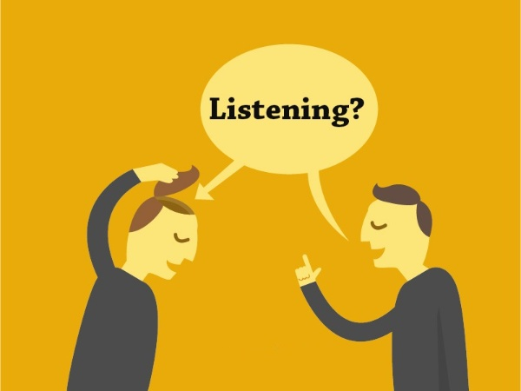
Now, listen to few things very carefully…

Slide 12
Finally, one thing I personally believe and always try to follow-
Be honest, disciplined and punctual or don't be at all. ☺

Slide 13

END

